Slide 1
Group I
Shani levi
Max Tyuliandine
Omri Assayag
Haim leshem
Lior yermi
Ben Schajnovitz

Slide 2
Contents
Requirements- login and currency
User stories- login and currency
Use case diagram – login and dashboard
Currency sequence diagram
Risks

Slide 3
Use Case-Requirements
Login Requirements:
1. The user should have the option to select the “Register”
in order to connect to his personal dashboard.
2. The user should have the option “login” ,that Connect to the system
and watch the dashboard that containing the widgets.
3. The list of widgets is displayed to the user.
4. The user can choose from the list of widgets being displayed,
which widget he would like to use
Currency Requirements:
5. The user will be able to choose a coin type and get the current currency rate.
6. The user will be able to choose a currency type and Insert quantity to convert ,
and get the conversion from NIS to the specific coin.

Slide 4
Use Case-User stories
Login and dashboard User stories:
As a user I will be able to create an account in the system,
in order to connect my own dashboard.
As a user I will be able to see the list of widgets I can use,
so that I can select the optimal option.
3. As a user I want to have the option to select a widget from the dashboard,
and use it.
Currency User stories:
1. As a user I will be able to insert coin type and get the current currency rate.
2. As a user I will be able to insert quantity and coin type and get
the conversion.

Slide 5
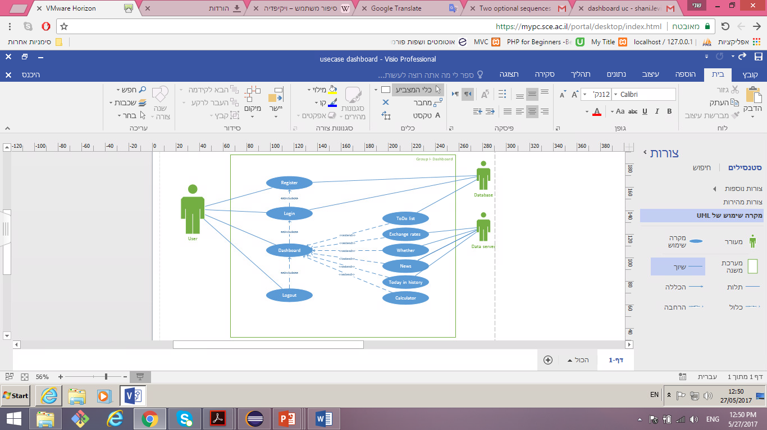
Use Case-diagram

Slide 6
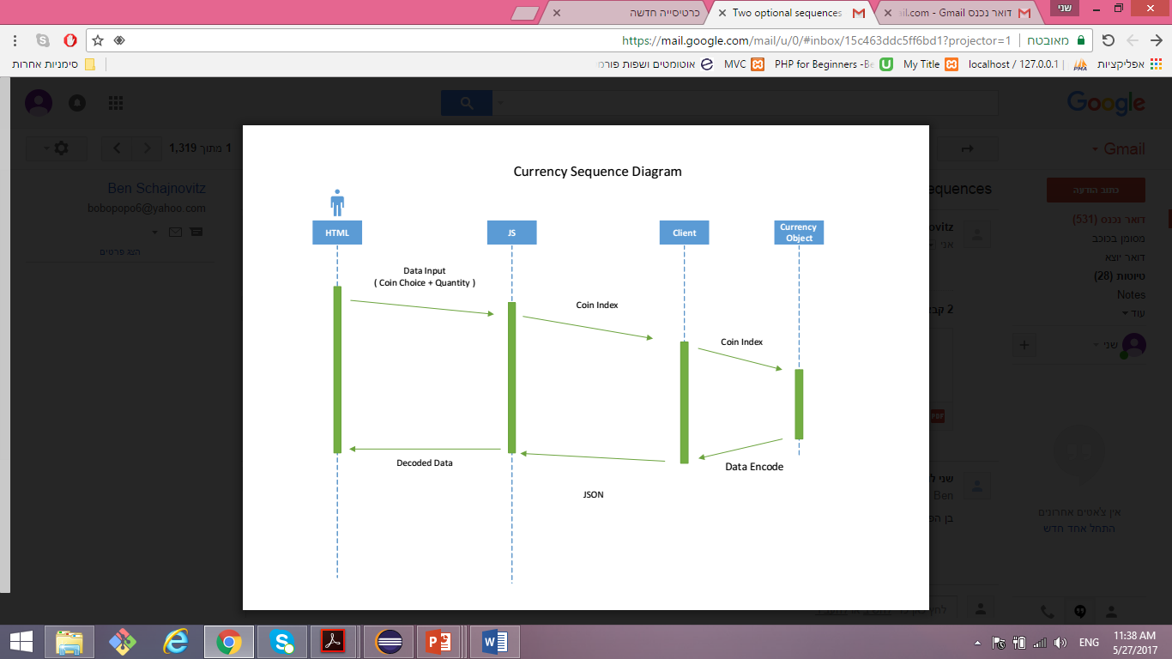

Slide 7
Risks
Non-compliance with requirements
Risk identification :
The main risk we identified at the beginning of the project was due to the difficulty in understanding the requirements.
We were required to make a separation between the server side (php) and the client side (java script), The lack of knowledge with the contents made it difficult to understand and implement the concept.
And the risk was that we would not compliance with the requirements

Slide 8
Risks
Non-compliance with requirements
Risk characterization:
The probability that the risk would occur if we did not act accordingly was very high. We were required to learn new contents that we did not know before, and the concept was new to us.
And of course, the impact of non-compliance is very critical.
Control and response:
As part of the project, we had the guidance and assistance from the practitioner and we had the opportunity to ask questions and make sure if our progress is on the right or that some changes were needed.

Slide 9
Risks
The external server will not provide the required information
Risk identification :
Some of the widgets we were required to prepare took information from an external API.
During the project another risk arose is that the site will crash or that the XML / RSS file will be suddenly changed.
Risk characterization:
The probability of this risk is low but if it does happens the impact is critical.
Control and response:
We did check status to make sure that everything is received and ready for printing. If not, the widget will react accordingly and send an alert.

Slide 10
Thank you!

